Slide 1
The use of music in Holocaust education for secondary school students (Jewish and non-Jewish)
Thursday, March 03, 2016

Slide 2
47
Total Responses
Date Created: Wednesday, December 02, 2015
Complete Responses: 40

Slide 3
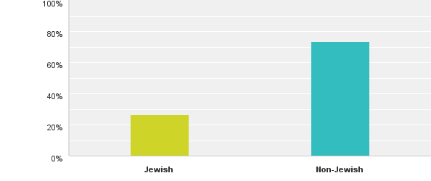
Q1: Was the class in a Jewish or non-Jewish educational setting?
Answered: 45 Skipped: 2

Slide 4
Q1: Was the class in a Jewish or non-Jewish educational setting?
Answered: 45 Skipped: 2

Slide 5
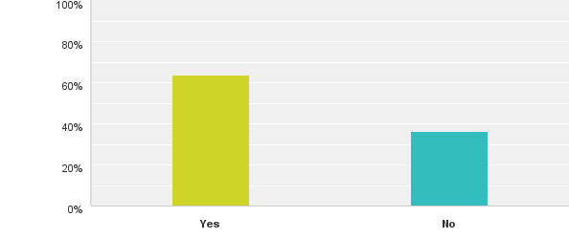
Q2: Was music used in your Holocaust curriculum? (If not, you may click through and click "Done”.)
Answered: 44 Skipped: 3

Slide 6
Q2: Was music used in your Holocaust curriculum? (If not, you may click through and click "Done”.)
Answered: 44 Skipped: 3

Slide 7
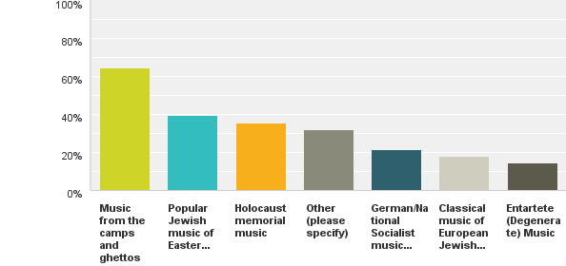
Q3: If music was used in your Holocaust curriculum, what type was used?
Answered: 28 Skipped: 19

Slide 8
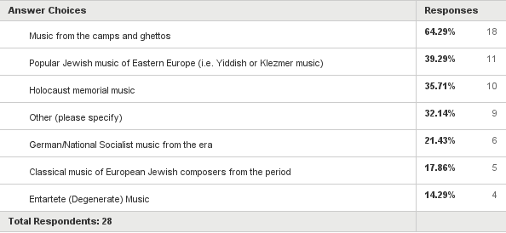
Q3: If music was used in your Holocaust curriculum, what type was used?
Answered: 28 Skipped: 19

Slide 9
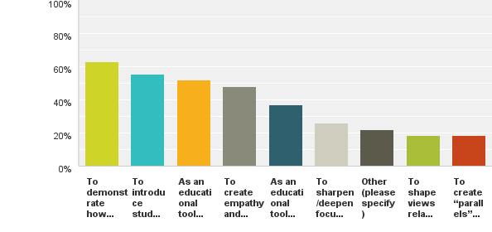
Q4: What was the purpose for using music in your course?
Answered: 27 Skipped: 20

Slide 10
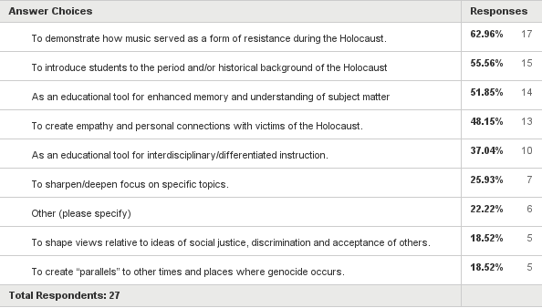
Q4: What was the purpose for using music in your course?
Answered: 27 Skipped: 20

